Slide 1


Social Buzz

Slide 2


Today's agenda
Project recap
Problem
The Analytics team
Process
Insights
Summary

Slide 3

Social Buzz, a burgeoning social media unicorn, is gearing up for rapid expansion. To fuel this growth, Accenture has embarked on a dynamic three-month collaboration. Their mission:
Conduct an extensive audit of Social Buzz's big data practice.
Craft strategic recommendations aimed at ensuring a smooth and successful IPO.
Delve into an in-depth analysis of Social Buzz's content categories to unveil the top five categories commanding the highest aggregate popularity.
Project Recap

Slide 4




Problem
Utilize advanced analytics to sift through the daily influx of over 100,000 content pieces and extract valuable insights.
Implement targeted advertising and personalized recommendations to optimize user engagement and drive revenue from a user base spanning tens of millions.

Slide 5




Andrew Fleming
Chief Technology Architect
The Analytics team
Marcus Rompton
Senior Principal
Ankit Thakur
Data Analyst

Slide 6

Process
1
Data Understanding
2
Data Cleaning
3
Data Modelling
4
Data Analysis
5
Uncover Insights

Slide 7

Insights
16
Unique Category
1897
Reactions to ‘Animal’ Posts
MAY
Month with Most posts

Slide 8
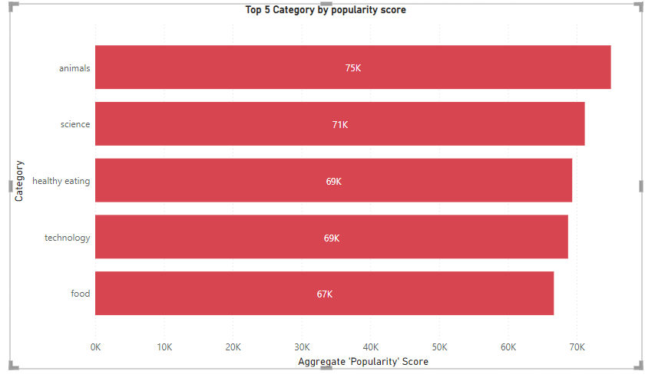

Slide 9
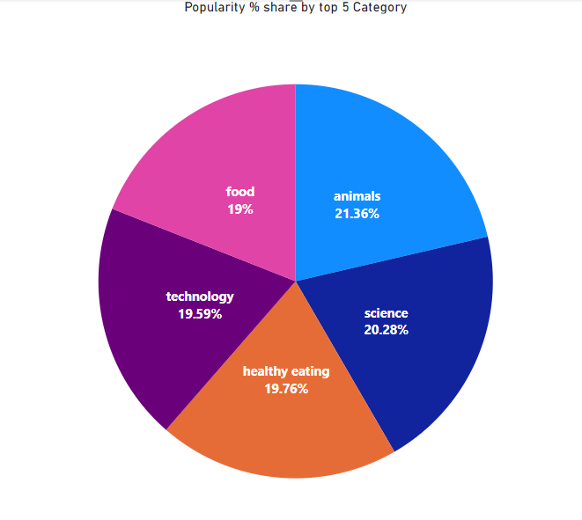

Slide 10
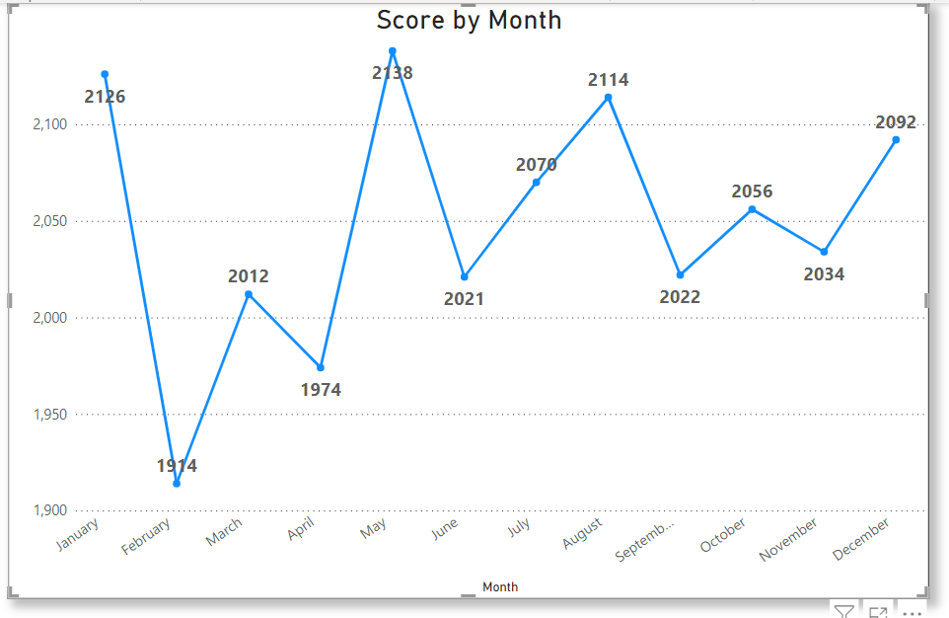

Slide 11


Analysis:
Animals and science emerge as the two most popular content categories, indicating a preference for 'real-life' and 'factual' content among users.
Insight:
Healthy eating is the overarching theme among the top five categories, with 'Healthy Eating' ranking the highest. This suggests a significant interest within the user base towards wellness and nutrition-related content.
Next Steps:
While this ad-hoc analysis provides valuable insights, it's time to transition to large-scale production for real-time understanding of the business dynamics.
Utilize this insight to strategize and collaborate with healthy eating brands, leveraging their products and messaging to boost user engagement and capitalize on the audience's interests.
Summary

Slide 12
Thank you!
ANY QUESTIONS?

